Slide 1


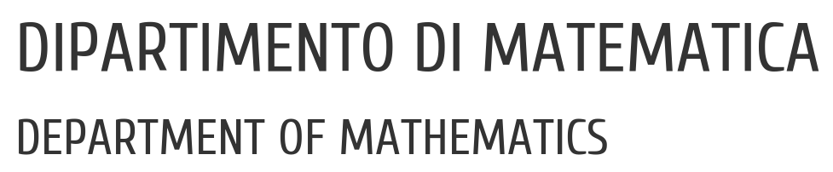

UNIVERSITY OF PADUA
UNIVERSITA’ DEGLI STUDI DI PADOVA
Instance Segmentation of Urban Street Scenes
Francesco Bari, Eleonora Signor
Vision and Cognitive Services - Prof. Lamberto Ballan
21 Febbraio 2022

Slide 2



UNIVERSITY OF PADUA
UNIVERSITA’ DEGLI STUDI DI PADOVA
Table of contents
Introduction
Related Work
Datasets
Method
Experiments
Conclusion
HOW?
WHY?
WHAT?

Slide 3


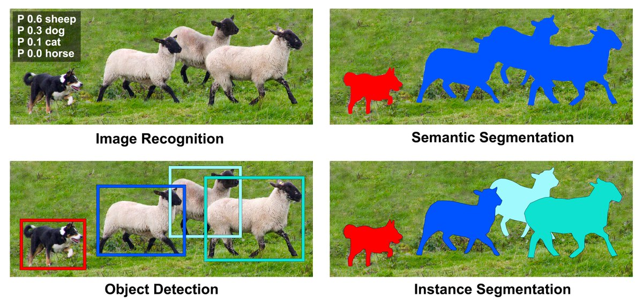
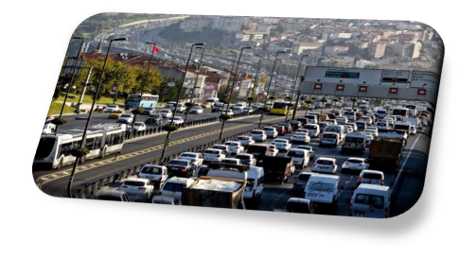
UNIVERSITY OF PADUA
UNIVERSITA’ DEGLI STUDI DI PADOVA
Introduction
instance segmentation for Urban Street Scenes

Slide 4
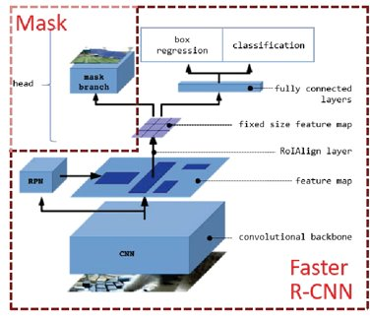
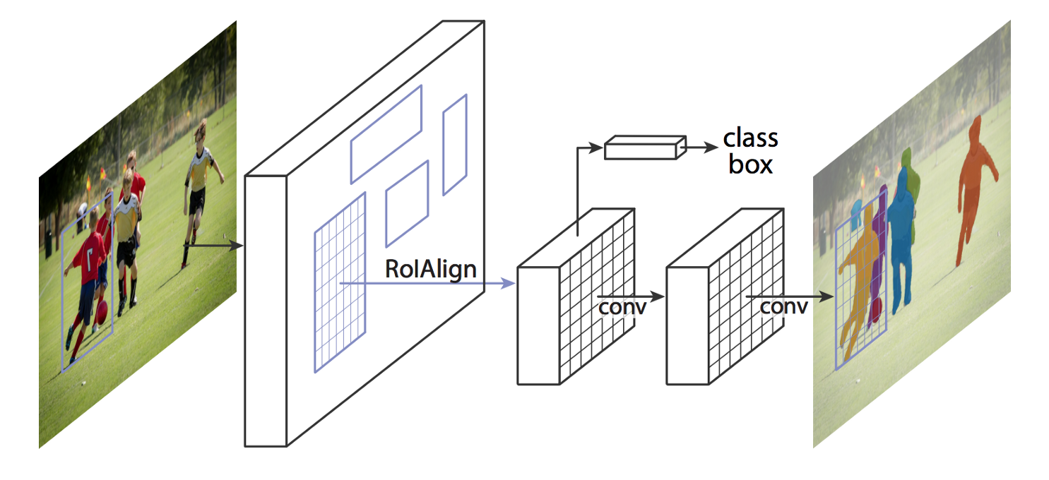


UNIVERSITY OF PADUA
UNIVERSITA’ DEGLI STUDI DI PADOVA
Related Work : stage approch, Mask R-CNN
box - based two stage approch
generates a segmentation mask for each instance
Region Proposal Network
class label, bounding box offset and object mask
backbone and head
RoIAlign
complicated scenarios
multi-task networks

Slide 5
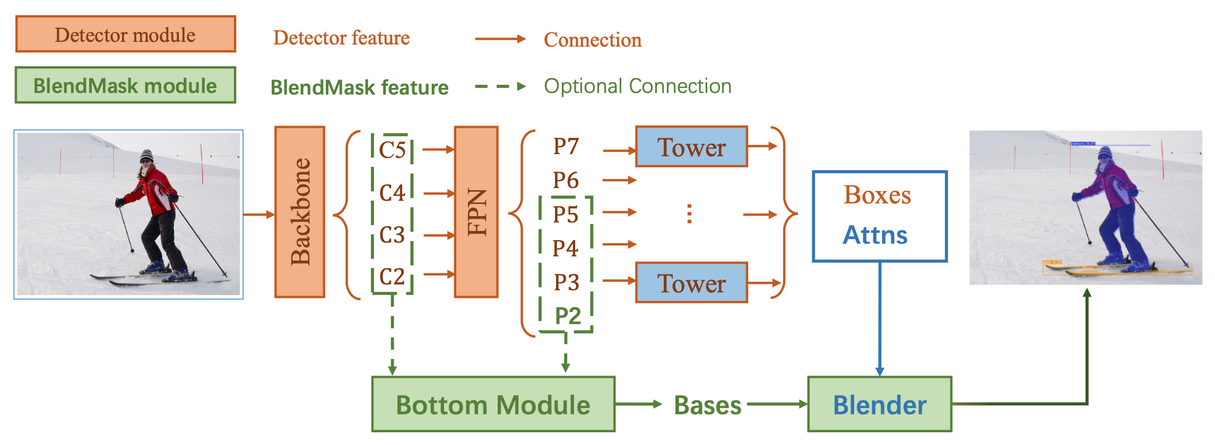
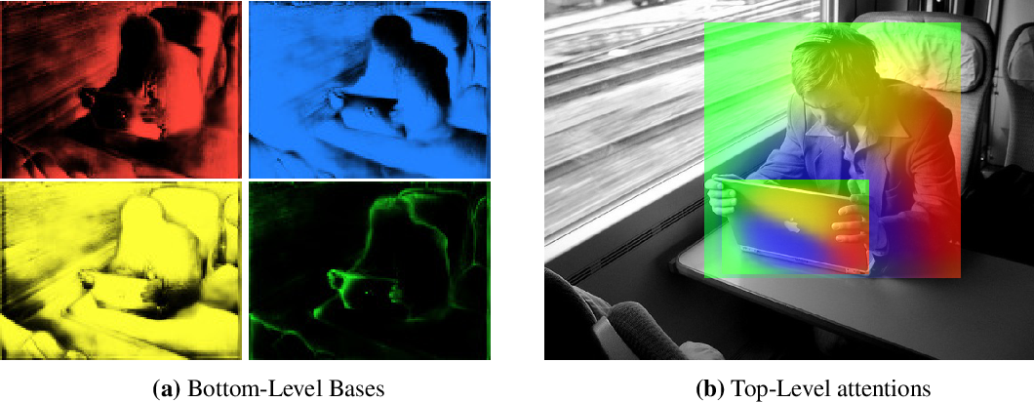


UNIVERSITY OF PADUA
UNIVERSITA’ DEGLI STUDI DI PADOVA
Related Work : stage approch, BlendMask
from the limits of Mask R-CNN
anchor box-free one-stage approach
it is composed of 3 parts:
- bottom module deals with the production of the bases
- top layer a single convolution layer, one for each tower. Predictions attention instances;
- blender module combines bases with attentions
theoretically better in time and precision

Slide 6

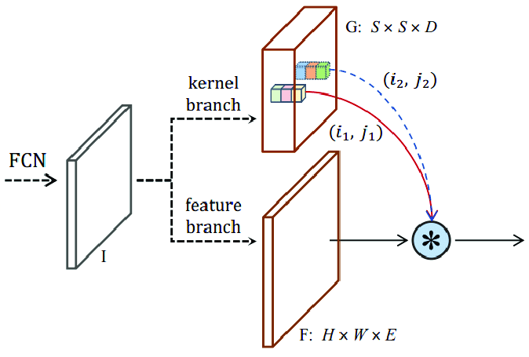
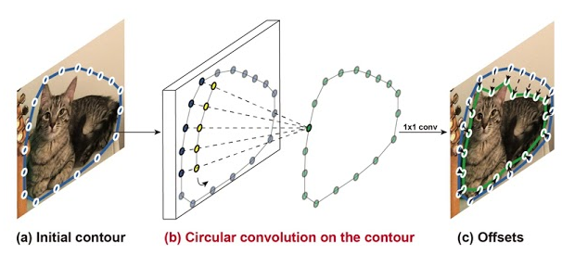
UNIVERSITY OF PADUA
UNIVERSITA’ DEGLI STUDI DI PADOVA
Related Work : others
SOLOv2
Deep Snake
box-free one-stage approach
mask kernel prediction and mask feature learning
matrix non-maximum suppression (NMS)
contour-based approach
initial contour proposal iteratively deforms
Circular Convolution

Slide 7
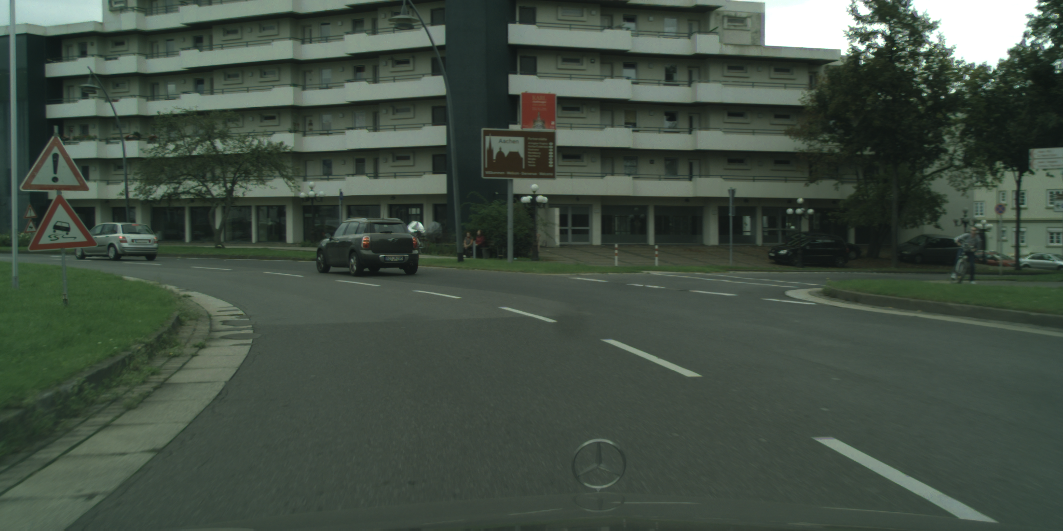
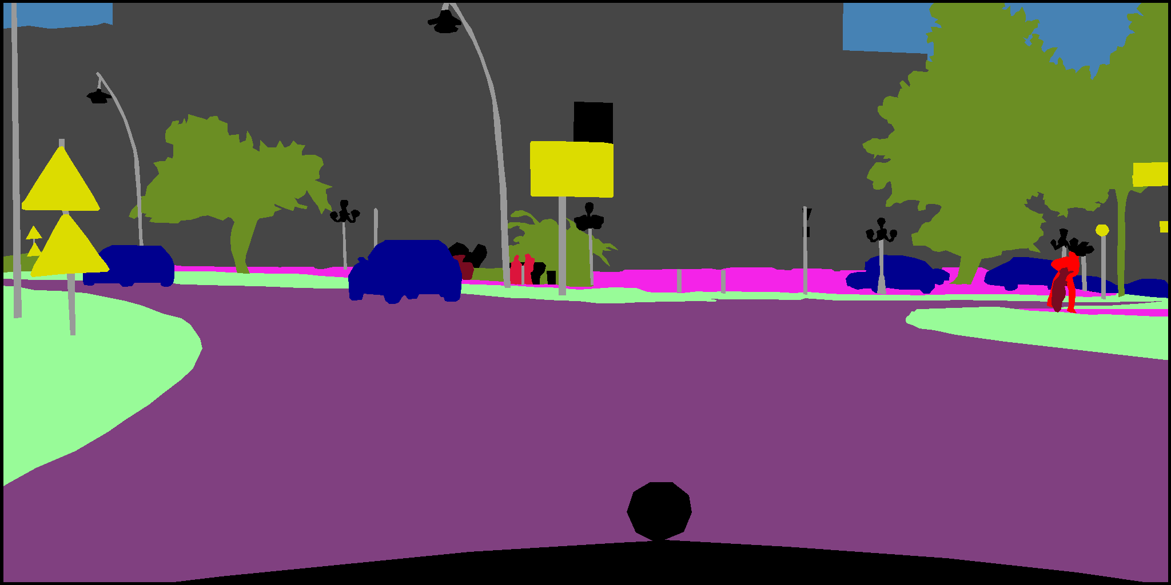
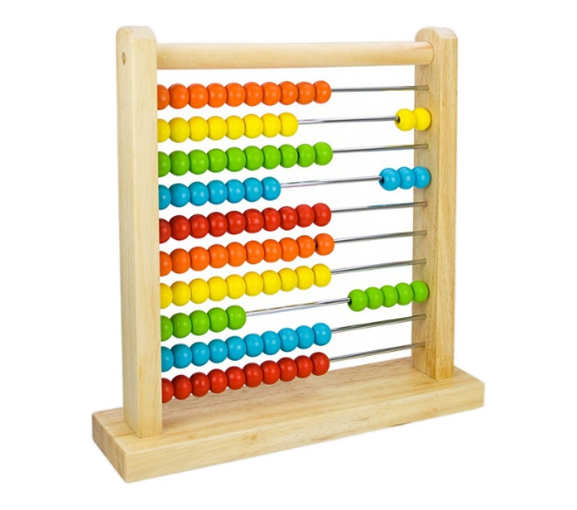
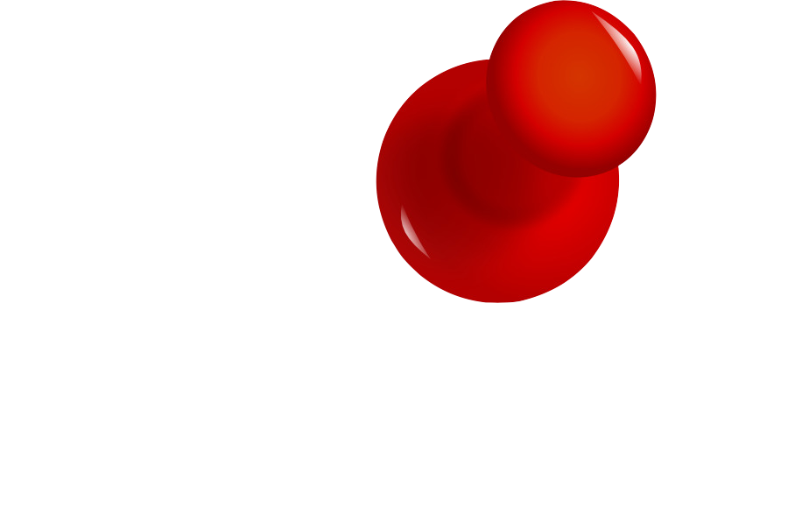
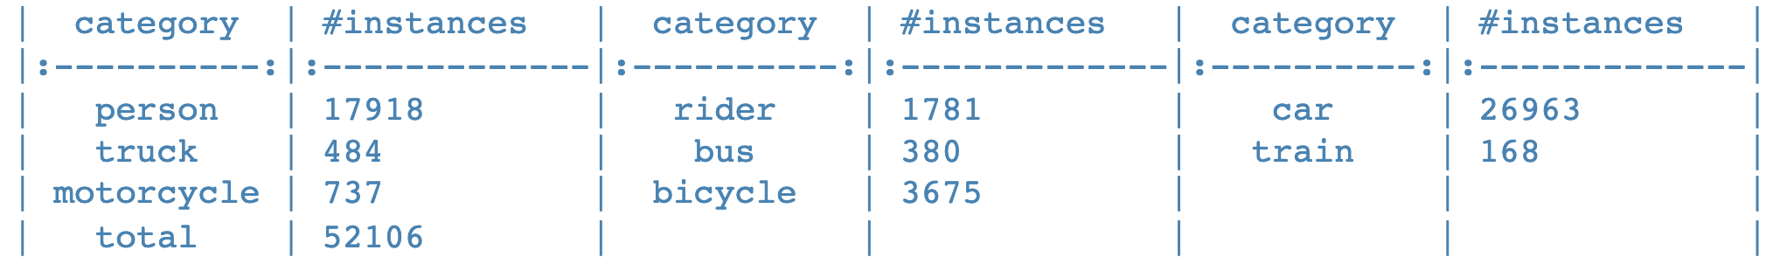

UNIVERSITY OF PADUA
UNIVERSITA’ DEGLI STUDI DI PADOVA
Datasets: Cityscapes
benchmarks and large-scale datasets for semantic urban scene understanding
Video sequences, recorded in 50 different cities
high-quality annotations, or/and coarse annotation
gtFine and leftImg8
HOW MUTCH?
3475 train/val images
1525 test images
5000 total images
8 total classes
PROBLEM: always images in good weather conditions

Slide 8
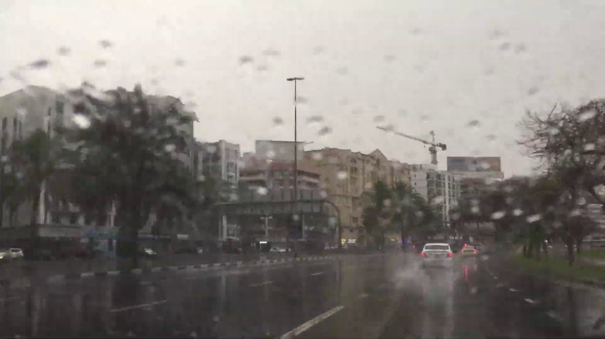


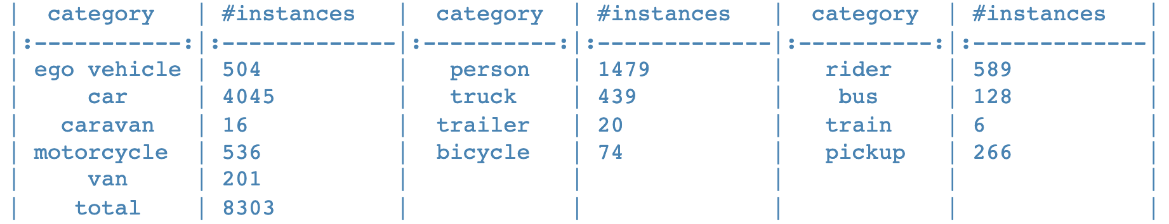

UNIVERSITY OF PADUA
UNIVERSITA’ DEGLI STUDI DI PADOVA
Datasets: WildDash
benchmark suite and dataset for semantic and instance segmentation for the automotive domain
scenarios such as rain, darkness and road cover
public gt package
CHALLENGES
HOW MUTCH?
4256 total images
3405 train images
851 test images
13 total classes

Slide 9






UNIVERSITY OF PADUA
UNIVERSITA’ DEGLI STUDI DI PADOVA
Method
Detectron2
AdelaiDet
ideal models found during the experiments
metrics for concretise the concept of comparison

Slide 10
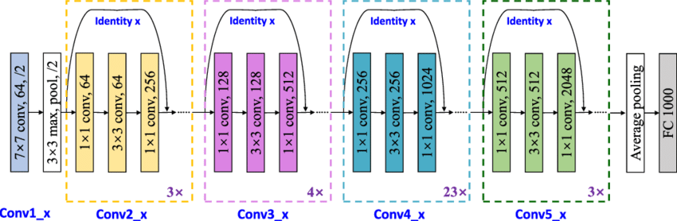
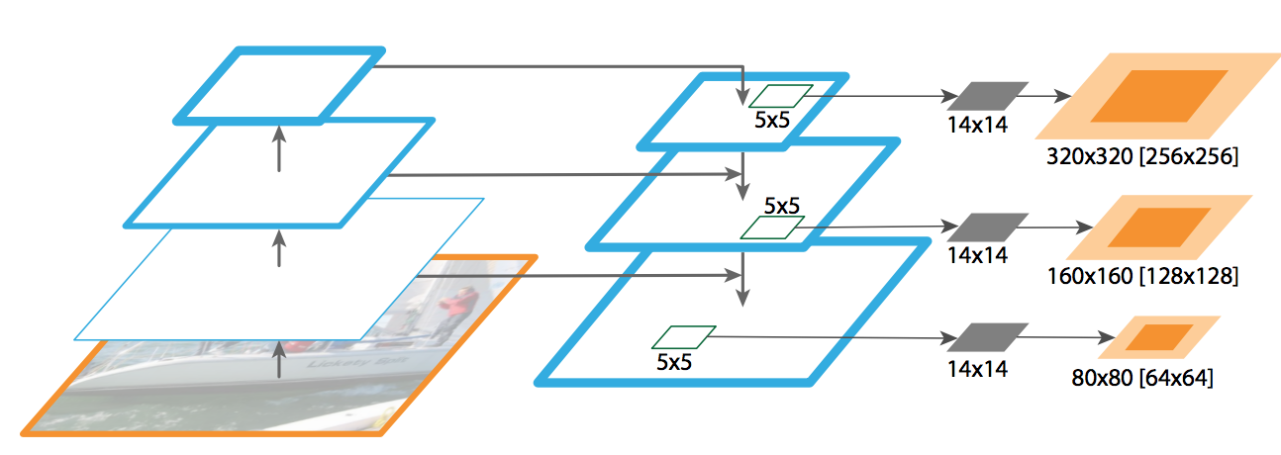

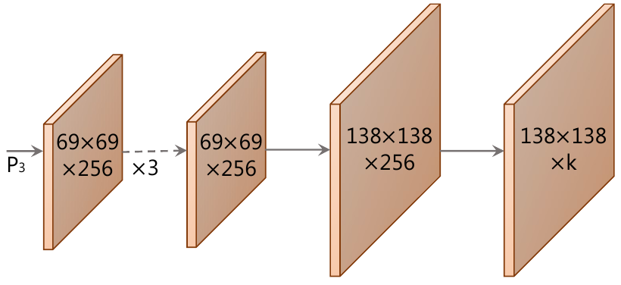

UNIVERSITY OF PADUA
UNIVERSITA’ DEGLI STUDI DI PADOVA
Method: architecture
we decided to use ResNet-101-FPN as the backbone
in addition, as the bottom module of BlendMask, we have instantiated ProtoNet

Slide 11
UNIVERSITY OF PADUA
UNIVERSITA’ DEGLI STUDI DI PADOVA
Method: hyperparameters

Slide 12
UNIVERSITY OF PADUA
UNIVERSITA’ DEGLI STUDI DI PADOVA
Method: loss functions

Slide 13
UNIVERSITY OF PADUA
UNIVERSITA’ DEGLI STUDI DI PADOVA
Method: evaluation

Slide 14
UNIVERSITY OF PADUA
UNIVERSITA’ DEGLI STUDI DI PADOVA
Experiments

Slide 15
UNIVERSITY OF PADUA
UNIVERSITA’ DEGLI STUDI DI PADOVA
Experiments: backbone

Slide 16
UNIVERSITY OF PADUA
UNIVERSITA’ DEGLI STUDI DI PADOVA
Experiments: frozen layers

Slide 17
UNIVERSITY OF PADUA
UNIVERSITA’ DEGLI STUDI DI PADOVA
Experiments: Ideal Models

Slide 18
UNIVERSITY OF PADUA
UNIVERSITA’ DEGLI STUDI DI PADOVA
Experiments: results

Slide 19


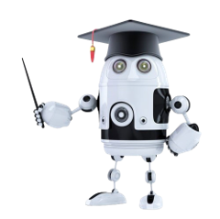
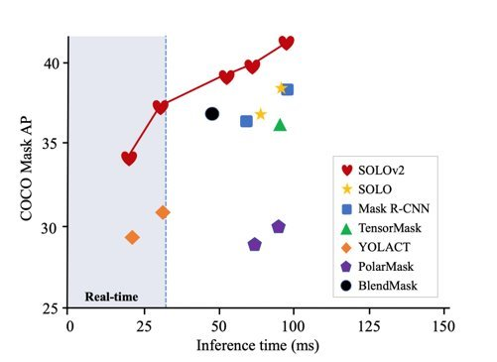
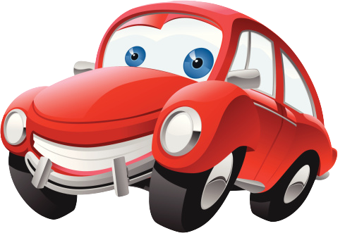
UNIVERSITY OF PADUA
UNIVERSITA’ DEGLI STUDI DI PADOVA
Conclusion
one-stage and anchor box-free techniques, suitably modified, perform better than box-based two-stage methods
caused by the hybridisation of top-down and bottom-up
methods and the detection of unanchored objects
BLENDMASK wins in Average Precision and Time against Mask R-CNN
you can do better ….
a box-free stage approach combined with matrix NMS, such as SOLOv2, is demonstrated to be very competitive against BlendMask

Slide 20
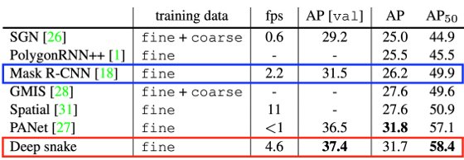


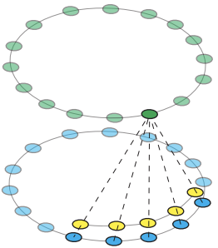
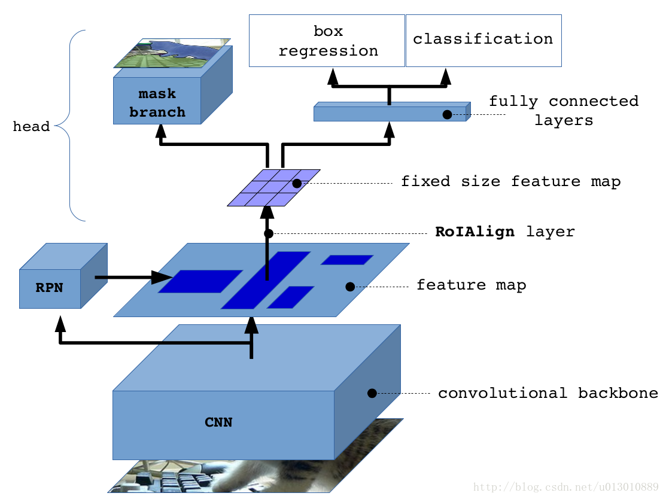

UNIVERSITY OF PADUA
UNIVERSITA’ DEGLI STUDI DI PADOVA
Conclusion: possible extensions
Deep Snake outperforms Mask R-CNN in inference speed and AP
improve the performance of BlendMask by trying to use Deep Snake contour-based approach for detecting object bounding boxes of an image

Slide 21
UNIVERSITY OF PADUA
UNIVERSITA’ DEGLI STUDI DI PADOVA
Progetto nome
Grazie per l’attenzione!

